Slide 1

Understanding Foundations of TensorFlow
Hrisheekesh R Senior Data Analyst, Attinad Software
www.attinadsoftware.com

Slide 2

Introduce TensorFlow(TF), a language for numerical computations
Understand the basics of machine learning, deep learning and neural networks
Learn why TF is slowly becoming the default library for ML
Install and set up TensorFlow on your local machine
Overview

Slide 3
What You Need in Your Toolkit

Slide 4

Prerequisites
Familiarity with the command line on a Mac, Linux or Windows machine
Comfortable with writing programs in Python

Slide 5
Install and Setup
The latest version of TensorFlow
A compatible version of Python, version 2.7 and 3.x
A Mac, Linux or Windows machine on which TensorFlow can be installed
Or
A browser like Firefox / Chrome

Slide 6

Overview
Introduction to TensorFlow, install and set up
Basics of TensorFlow, computation graphs, tensors, sessions and TensorBoard
Fundamentals of TensorFlow, placeholders, variables, the feed dictionary
Working with images, representing RGB and grayscale images, image operations
Machine Learning with TensorFlow, identifying handwritten digits in the MNIST dataset using the nearest neighbors algorithm

Slide 7
Understanding Machine Learning

Slide 8



Machine Learning
Work with a huge
maze of data
Make intelligent
decisions
Find patterns

Slide 9
A machine learning algorithm is an
algorithm that is able to learn from data

Slide 10





Machine Learning
Emails on a server Spam or Ham? Trash or Inbox

Slide 11



Machine Learning
Images represented
as pixels
Identify edges,
colors, shapes
A photo of a
little bird

Slide 12




Types of Machine Learning Problems
Classification Regression Clustering Rule-extraction

Slide 13


Whales: Fish or Mammals?
Mammals
Members of the infraorder
Cetacea
Fish
Look like fish, swim like fish,
move with fish

Slide 14
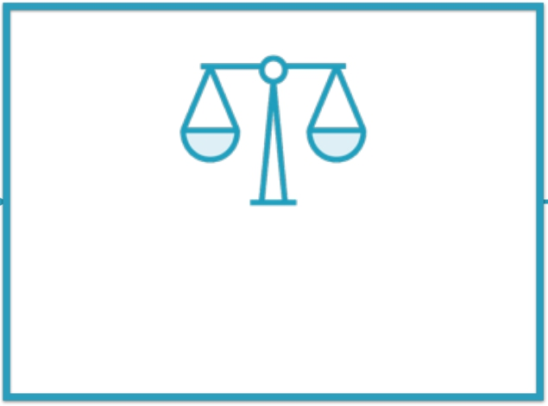

Rule-based Binary Classifier
Whale Mammal
Rule-based Classifier
Human Experts

Slide 15

ML-based Binary Classifier
Breathes like a mammal
Gives birth like a
mammal
Mammal
ML-based Classifier
Corpus

Slide 16

“Traditional” ML-based Binary Classifier
Moves like a fish,
Looks like a fish
Fish
ML-based Classifier
Corpus

Slide 17

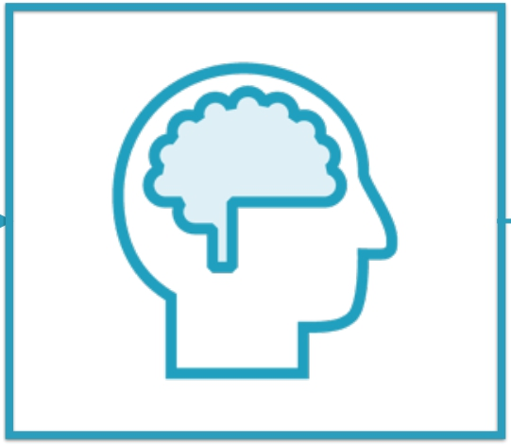
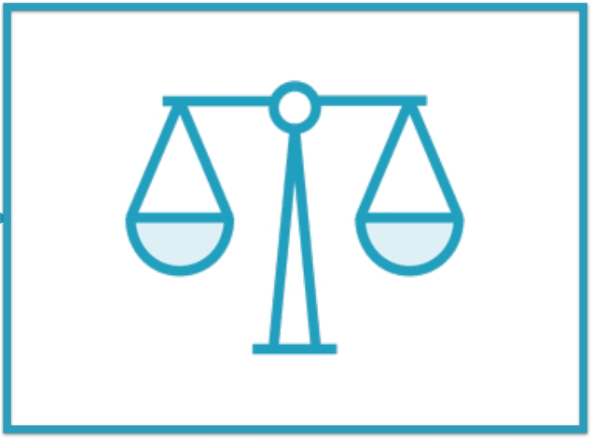
ML-based Binary Classifier
Corpus
Classification
Algorithm
ML-based Classifier

Slide 18
ML-based Binary Classifier
ML-based Rule-based
Dynamic
Experts optional
Corpus required
Training step
Static
Experts required Corpus optional No training step

Slide 19
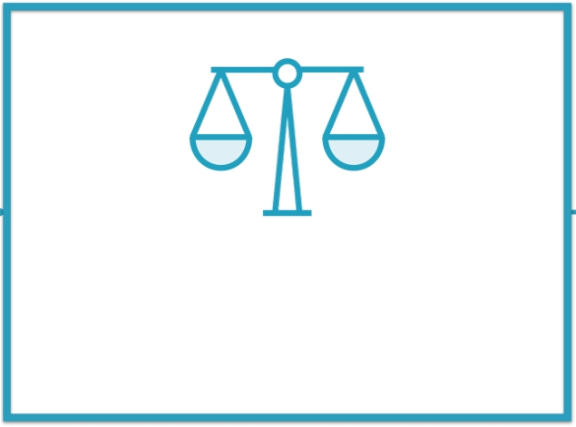
“Traditional” ML-based Binary Classifier
Breathes like a mammal
Gives birth like a
mammal
Mammal
ML-based Classifier
Corpus

Slide 20


“Traditional” ML-based Binary Classifier
Breathes like a mammal
Gives birth like a
mammal
Mammal
ML-based Classifier
Input: Feature Vector
Corpus

Slide 21


“Traditional” ML-based Binary Classifier
Breathes like a mammal
Gives birth like a
mammal
Mammal
ML-based Classifier
Output: Label
Corpus

Slide 22
“Traditional” ML-based Binary Classifier
Moves like a fish,
Looks like a fish
Fish
ML-based Classifier
Corpus

Slide 23


“Traditional” ML-based Binary Classifier
Moves like a fish,
Looks like a fish
Fish
ML-based Classifier
Input: Feature Vector
Corpus

Slide 24


“Traditional” ML-based Binary Classifier
Moves like a fish,
Looks like a fish
Fish
ML-based Classifier
Output: Label
Corpus

Slide 25
The attributes that the ML algorithm focuses on are called features
Each data point is a list - or vector - of such features
Thus, the input into an ML algorithm is a feature vector
Feature
Vectors

Slide 26
“Traditional” ML-based systems still
rely on experts to decide what
features to pay attention to

Slide 27
“Representation” ML-based
systems figure out by themselves
what features to pay attention to

Slide 28
Understanding Deep Learning

Slide 29
“Representation” ML-based
systems figure out by themselves
what features to pay attention to

Slide 30
“Traditional” ML-based Binary Classifier
Corpus
Classification
Algorithm
ML-based Classifier

Slide 31

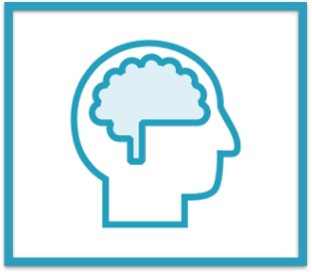
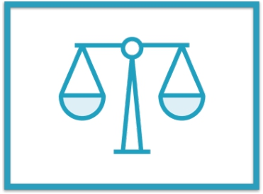
“Traditional” ML-based Binary Classifier
Corpus
Feature Selection
by Experts
Classification
Algorithm
ML-based Classifier

Slide 32




“Traditional” ML-based Binary Classifier
Corpus
Feature Selection
by Experts
Classification
Algorithm
ML-based Classifier

Slide 33




“Representation” ML-based Binary Classifier
Corpus
Feature Selection
Algorithm
Classification
Algorithm
ML-based Classifier

Slide 34
“Representation” ML-based Binary Classifier
Corpus
Feature Selection
Algorithm
Classification
Algorithm
ML-based Classifier

Slide 35
“Traditional” ML-based Binary Classifier
Breathes like a mammal
Gives birth like a
mammal
Mammal
ML-based Classifier
Corpus

Slide 36
“Representation” ML-based Binary Classifier
Picture or video of a
whale
Mammal
ML-based Classifier
Corpus

Slide 37
“Representation” ML-based Binary Classifier
Corpus
Feature Selection
Algorithm
Classification
Algorithm
ML-based Classifier

Slide 38
“Deep Learning” systems are one
type of representation systems

Slide 39
Deep Learning and Neural Networks

Slide 40
Deep Learning and Neural Networks
Deep Learning
Algorithms that learn what features matter
Neural Networks
The most common class
of deep learning
algorithms
Neurons
Simple building blocks
that actually “learn”

Slide 41
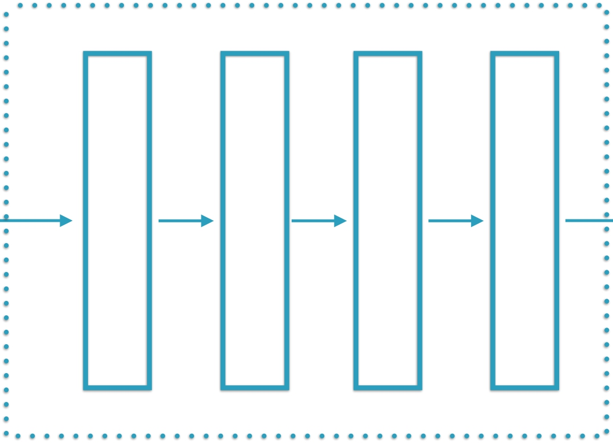
“Deep Learning”-based Binary Classifier
Pixels
Edges
Corners
Object Parts
Corpus of
Images
Feature Selection &
Classification Algorithm
ML-based Classifier

Slide 42
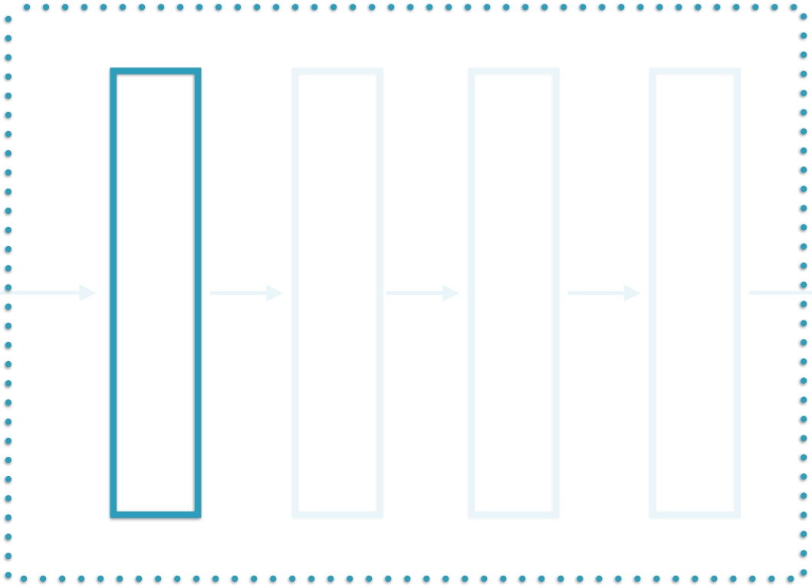


“Deep Learning”-based Binary Classifier
Pixels
Edges
Corners
Object Parts
Corpus of
Images
“Visible
layer”
ML-based Classifier

Slide 43
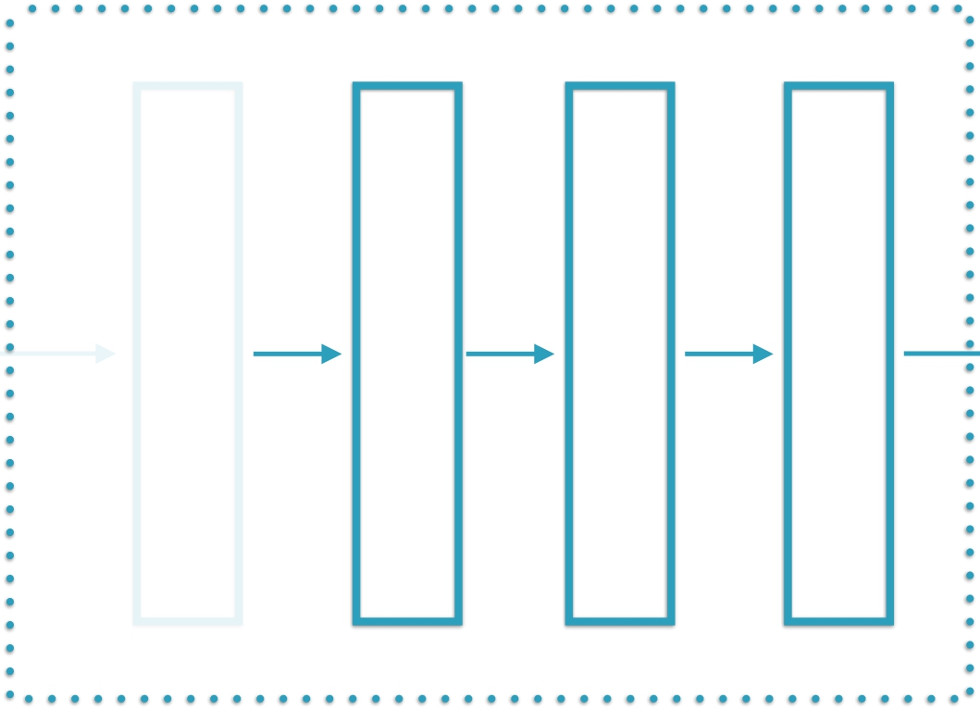
“Deep Learning”-based Binary Classifier
Pixels
Edges
Corners
Object Parts
Corpus of
Images
“Hidden
Layers”
ML-based Classifier

Slide 44

Neural Networks Introduced
Layer 1
Layer 2
…
Layer N
Corpus of
Images
Layers in a neural network
ML-based Classifier

Slide 45
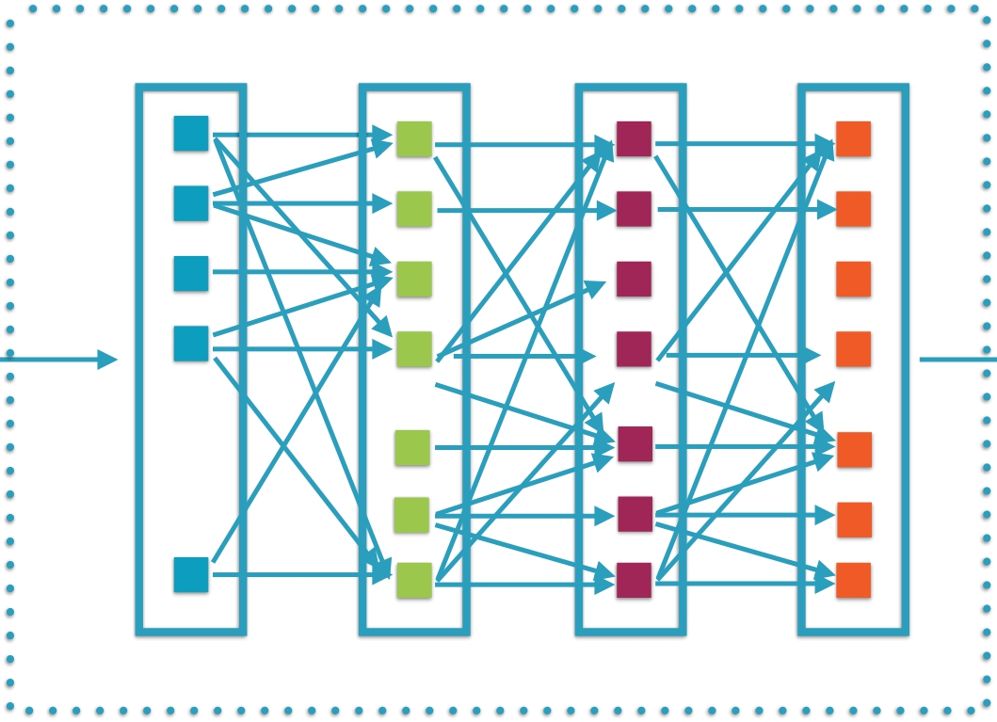
Neural Networks Introduced
…
Pixels Processed groups of pixels
Each layer consists of individual
interconnected neurons
Corpus of
Images
ML-based Classifier

Slide 46
Neural networks help find unknown
patterns in massive data sets

Slide 47
TensorFlow for Machine Learning

Slide 48
TensorFlow
TensorFlow™ is an open source software library for numerical computation using data flow graphs.
https://www.tensorflow.org/

Slide 49

TensorFlow
TensorFlow™ is an open source software library for numerical computation using data flow graphs.
https://www.tensorflow.org/

Slide 50
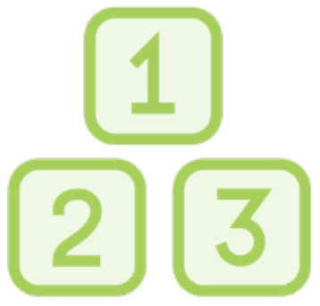
TensorFlow
TensorFlow™ is an open source software library for numerical computation using data flow graphs.
https://www.tensorflow.org/

Slide 51

TensorFlow
TensorFlow™ is an open source software library for numerical computation using data flow graphs.
https://www.tensorflow.org/

Slide 52

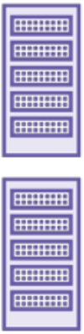
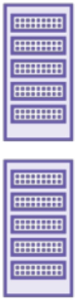
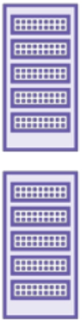
Advantages of TensorFlow
Distributed
Runs on a cluster or
machines or multiple CPUs/
GPUs on the same machine
Suite of software
TensorFlow,
TensorBoard,
TensorFlow Serving

Slide 53



TensorFlow
Uses Strengths Challenges

Slide 54

Uses
Research and development of new ML algorithms
Taking models from training to production
Large scale distributed models
Models for mobile and embedded systems

Slide 55

Strengths
Easy to use, stable Python API
Runs on large as well small systems Efficient and performant
Great support from Google
Additional tools like TensorBoard and TensorFlow serving

Slide 56

Challenges
Distributed support still has a ways to go
Libraries still being developed
Writing custom code is not straightforward

Slide 57
TensorFlow is on its way to
becoming the default library for
machine learning

Slide 58
The TensorFlow World

Slide 59

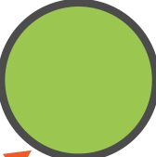




Everything is a Graph
A network

Slide 60





Everything is a Graph
Computations

Slide 61
Everything is a Graph
Operators

Slide 62






Everything is a Graph
Data

Slide 63
Everything is a Graph
Tensors

Slide 64
Tensors Flow Through the Graph
…and get transformed along the way

Slide 65






Tensors Flow Through the Graph
1.8
2
rnd
x
2
10
5
+
15
+
5
3
3.6
5
floor
abs
TensorFlow

Slide 66

Demo
Download and install TensorFlow on your local machine
Validate that the TensorFlow libraries work and can be referenced

Slide 67
Learnt the basics of machine learning, deep learning and neural networks
Understood the strengths and challenges of using TensorFlow for ML
Understood the modeling of problem as a computational graph
Got TensorFlow up and running on your local machine
Summary

